Slide 1
Digital Portfolio
STUDENT NAME: R. RAGAVI
REGISTER NO AND NMID: 2314110500122015
DEPARTMENT: BCA
COLLEGE: VIVEKANANDA ARTS AND SCIENCE FOR WOMEN COLLEGE/ ANNAMALAI UNIVERSITY

Slide 2
PROJECT TITLE
Digital portfolio

Slide 3


AGENDA
Problem Statement
Project Overview
End Users
Tools and Technologies
Portfolio design and Layout
Features and Functionality
Results and Screenshots
Conclusion
Github Link
3/21/2024 Annual Review

Slide 4
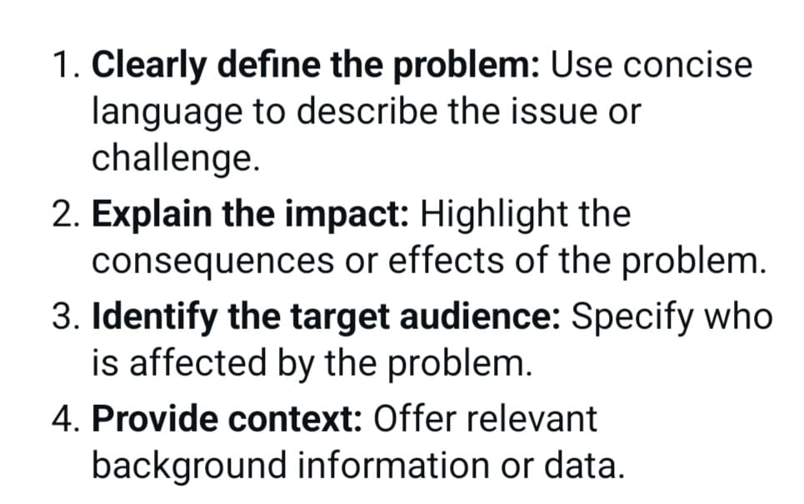

PROBLEM STATEMENT

Slide 5
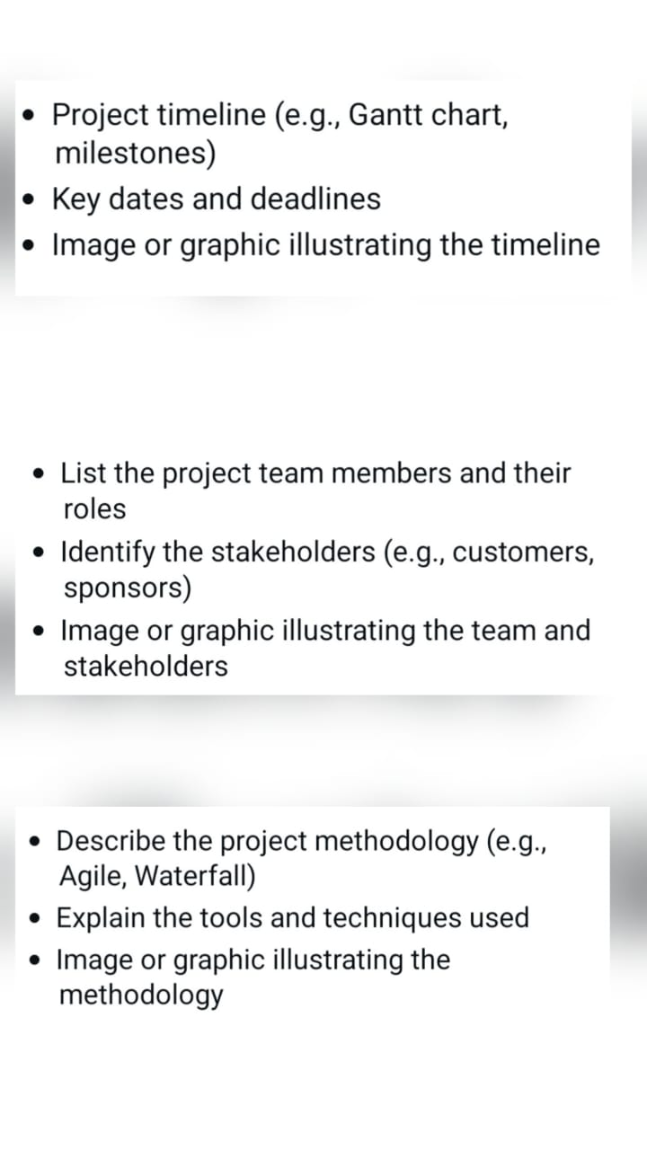

PROJECT OVERVIEW

Slide 6
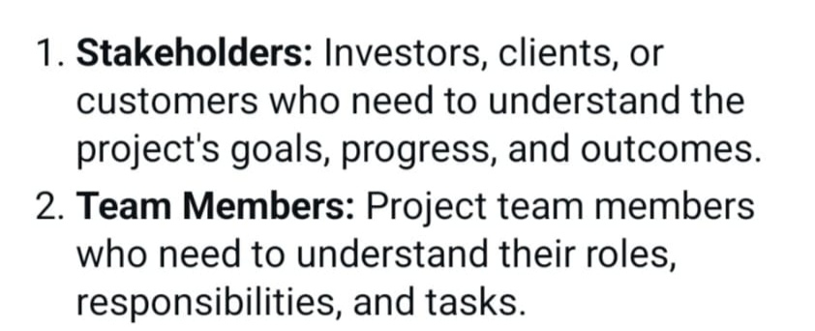

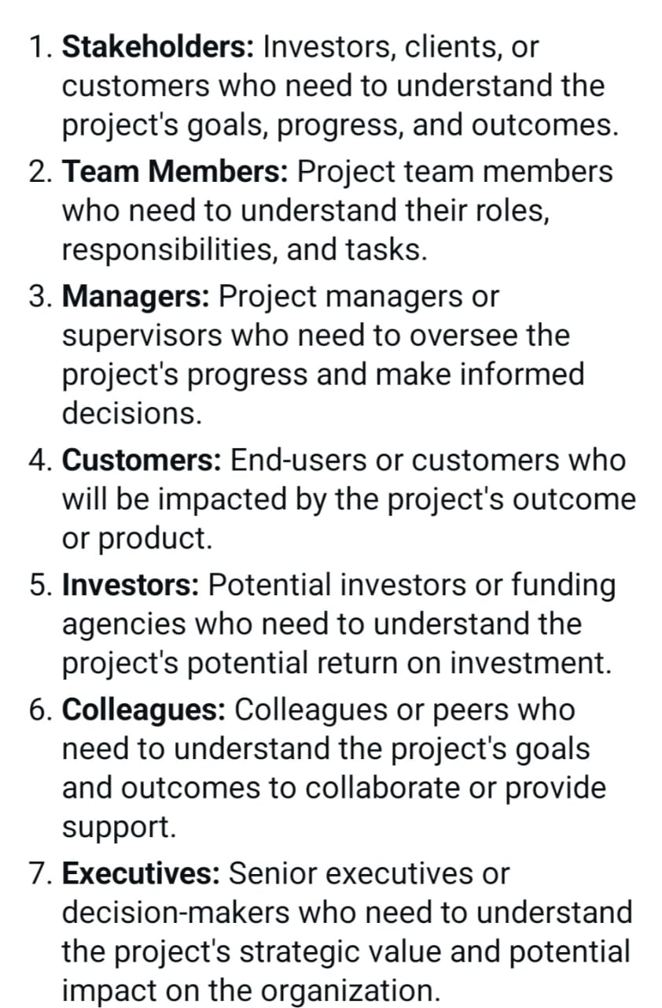
WHO ARE THE END USERS?

Slide 7

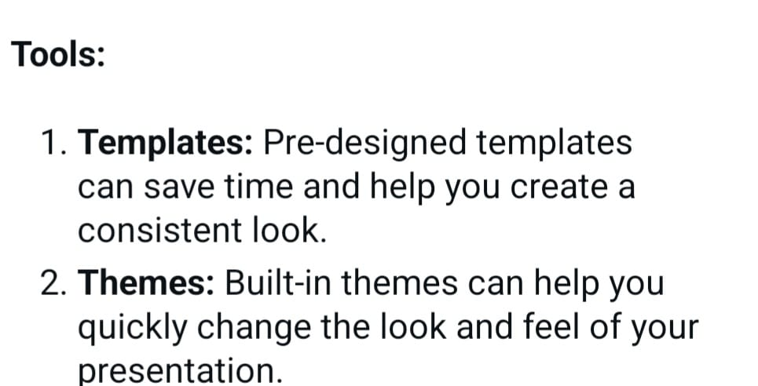
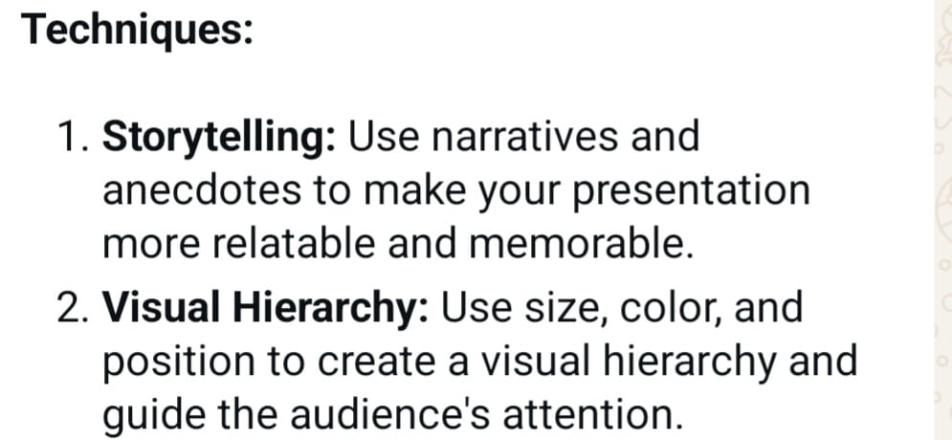
TOOLS AND TECHNIQUES

Slide 8
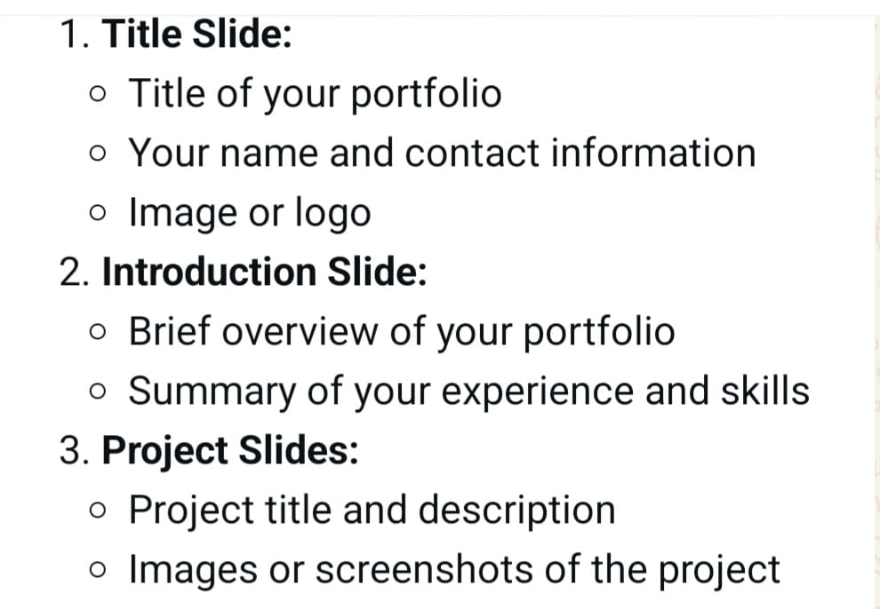
POTFOLIO DESIGN AND LAYOUT
8

Slide 9
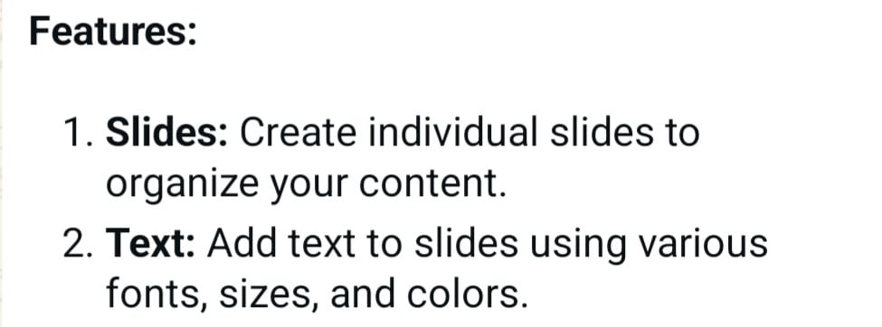
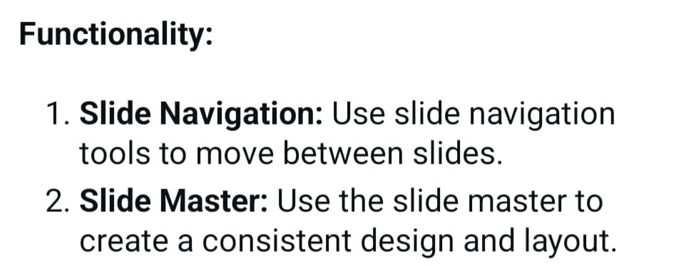
FEATURES AND FUNCTIONALITY

Slide 10
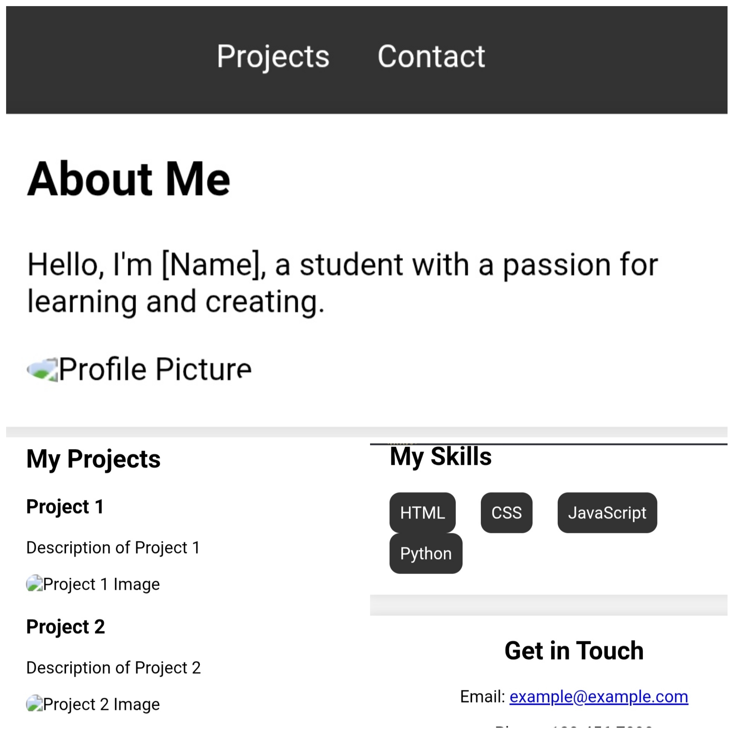

RESULTS AND SCREENSHOTS
3/21/2024 Annual Review
10

Slide 11

CONCLUSION
https://github.com/rragavibca24-ux/Ragavi_TNDSC_FWD.git
11

